Slide 1
Chapter 2: Historical Roots of the Global Economy
“Written into the long history our planet, in one form or another, is the record of what is coming our way.”
Julia Whitty, writer and filmaker

Slide 2
Manorialism, Domestic Economy under Feudalism
Notes:
Peasant plowing on a French manor, 1410. A domestic economy before capitalist principles developed. Wikipedia

Slide 3
Medieval European Manor, note the Commons
Notes:
Generic map of a medieval manor, showing strip farming, from William R. Shepherd, Historical Atlas, 1923. Wikipedia

Slide 4
Western European Economy Prior to 1500
Notes:
Guilds were part of the urban economy before capitalism developed. A center of urban government: the Guildhall, London (engraving, ca 1805). Wikipedia

Slide 5
Guild Signs, Europe
Notes:
Traditional wrought-iron guild sign of a glazier - in Germany. These signs can be found in many old European towns where guild members marked their places of business. Many survived through time or staged a comeback in industrial times. Today they are newly created or even restored, esp. in old town areas. Wikipedia

Slide 6
Columbus’ Voyages
Notes:
Voyages of Christopher Columbus beginning in 1492. Wikipedia

Slide 7
Columbus Staking Claim
Notes:
Staking claim in the Western hemisphere. Wikipedia

Slide 8
Mercantilism in France
Notes:
French finance minister and mercantilist Jean-Baptiste Colbert, a practitioner of mercantilism served for over 20. years. While many nations practiced it, one leading exemplar was France, the economically most important state, where king Louis XIV followed the guidance of Jean Baptiste Colbert, his controller general of finances (1662-83). They were determined that the state should rule in the economic realm as it did in the diplomatic, and that the interests of the state as identified by the king were superior to those of merchants and everyone else. Right Louis XIV (1643-1715) Wikipedia

Slide 9
Mercantilism, Anglo Dutch Wars
Notes:
Anglo Dutch Wars were a series of wars fought between the English (later British) and the Dutch in the 17th and 18th centuries for control over the seas and trade routes. The Dutch reached their height during the second and third wars 1665-1667 and 1672-1674. Eventually the Dutch declined as a core area, replaced by Britain. Wikipedia

Slide 10
Response to Mercantilism The Boston Tea Party
Notes:
This iconic 1846 lithograph by Nathaniel Currier was entitled "The Destruction of Tea at Boston Harbor"; the phrase "Boston Tea Party" had not yet become standard. Contrary to Currier's depiction, few of the men dumping the tea were actually disguised as Indians. In England, Parliament gave the East India Company a monopoly on the importation of tea in 1698. When tea became popular in the British colonies, Parliament sought to eliminate foreign competition by passing an act in 1721 that required colonists to import their tea only from Great Britain. Wikipedia

Slide 11
Enclosure Movement
Notes:
Decaying hedges mark the lines of the straight field boundaries created by the 1768 Parliamentary Act of Enclosure of Boldron Moor, County Durham in Britain. The enclosure movement privatized or commodified land that was previously owned by feudal landowners or in the commons. Wikipedia

Slide 12
Mining in the Western Hemisphere
Notes:
First image in Europe of the mountain of silver in Potosi, Bolivia. Wikipedia

Slide 13
Triangle Trade
Notes:
Depiction of the classical model of the Triangular trade. Wikipedia

Slide 14
Triangle Trade
Notes:
Depiction of the Triangular Trade of slaves, sugar, and rum with New England instead of Europe as the third corner.

Slide 15
Slave Trade
Notes:
Diagram illustrating the stowage of African slaves on a British slave ship. Wikipedia

Slide 16
The Beaver Wars
Notes:
The Beaver Wars — also known as the Iroquois Wars or the French and Iroquois Wars — encompass a series of conflicts fought in the mid-17th century in eastern North America. Beaver pelt, Wikipedia

Slide 17
British East India Company, flag
Notes:
Flag after 1801. Wikipedia

Slide 18
Industrial Capitalism in the Modern Era 1750-1914

Slide 19
Early Industrialization in Britain
Notes:
Cottonoplis, Early painting of cotton mills in Manchester, England. Wikipedia

Slide 20
Adam Smith, Classical Economic Theory
Notes:
Adam Smith (1723-1790), economist advocated for repeal of mercantilism and classical economics, free trade capitalism.

Slide 21
Robert Peel, repealed the Corn Laws
Notes:
Robert Peel became Conservative Prime Minister in 1841 and his government succeeded in repealing the tariffs and subsequent repeal of the Corn Laws in 1846. Wikipedia

Slide 22
Tariffs Illustration
Sewing Machine (in $) | United States | Britain
Cost to Manufacture | 10 | 5
Profit | 2 | 2
Cost of U.S. Consumer | 12 | 7
U.S. Tariff Added |  | +6
New Cost to U.S. Consumer | 12 | 13
Notes:
Not historically accurate, for illustration purposes only. Denise Ames
Tariff revenues were deposited into the U.S. treasury.

Slide 23
Industrialization, Cotton Mill
Notes:
Power loom weaving in 1835. Wikipedia

Slide 24
Mass Produc-tion
Notes:
Ford Assembly line in 1913. Wikipedia

Slide 25
Labor Strike
Notes:
Labor union demonstrators held at bay by soldiers during the 1912 Lawrence Textile Strike in Massachusetts, USA. Wikipedia

Slide 26
Gold Standard
Notes:
A gold standard is a monetary system in which the standard economic unit of account is based on a fixed quantity of gold.Under a gold standard, paper notes are convertible into preset, fixed quantities of gold.

Slide 27
Long Depres-sion
Notes:
Run on the Fourth National Bank, No. 20 Nassau Street, New York City, 1873. From Frank Leslie's Illustrated Newspaper, October 4, 1873.

Slide 28
Silver and Gold Conflict in the U.S. (1873-1896)
Free Silver | Gold Standard
Losers in the world economy | Winners in the world economy
Inflate the money supply | Deflate the money supply
Silver and gold standard | Gold standard
Debtors | Creditors
Rural | Cities
Free trade | Protective tariffs
Farmers, miners | Business, bankers
South and West | Northeast and cities of Midwest
Notes:
Denise Ames

Slide 29
Debtors and Creditors/Deflation and Inflation in Money Supply
Amount Borrowed | Deflation 10% Money Now Worth | Who Benefits, Who Does Not Benefit | Inflation 10% Money Now Worth | Who Benefits Who Does Not Benefit
$100 | $90 | Creditors benefit from deflation since money paid back in deflated dollars. Money paid back = $100 plus interest | $110 | Creditors do not benefit from inflation since money paid back in dollars worth less that when loaned. Money paid back = $100 plus interest
$200 | $180 | Debtors do not benefit from deflation, must come up with more money to pay back loan. Money paid back = $200 plus interest | $220 | Debtors benefit from inflation since money is paid back in dollars worth more than when borrowed. Money paid back = $200 plus interest
Notes:
Denise Ames

Slide 30
The White Man’s Burden
Notes:
According to this cartoon, What is the White Man’s Burden? Wikipedia

Slide 31
Imperialism, Cecil Rhodes
Notes:
"The Rhodes Colossus" – cartoon by Edward Linley Sambourne, published in Punch after Rhodes announced plans for a telegraph line from Cape Town to Cairo in 1892.
What is this cartoon trying to depict?

Slide 32
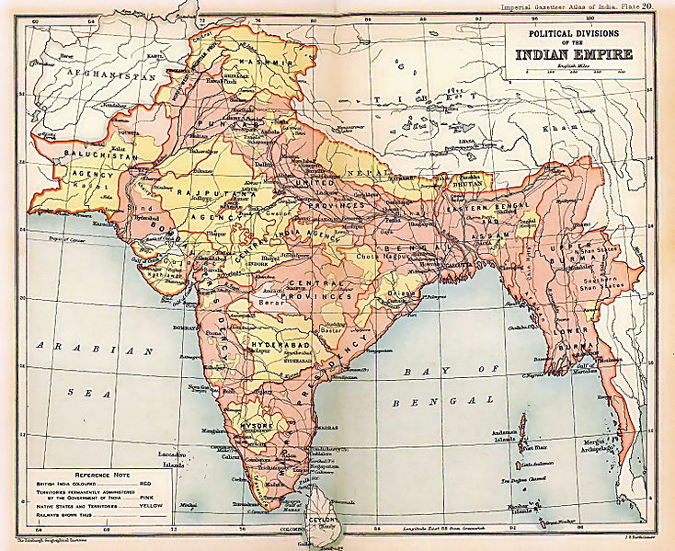
Notes:
Map of the British Indian Empire from Imperial Gazetteer of India. 1909. Wikipedia

Slide 33
Golden Era of Capitalism, Farming in Oklahoma
Notes:
Farming in Oklahoma in early 20th century. Farmers favored free trade, why? Wikipedia

Slide 34
Paris International Exposition 1900
Notes:
Paris International Exposition, 1900 symbolized a shift in core areas. What were the new core areas? Wikipedia

Slide 35
The Early Twentieth Century Economy
1914-1945

Slide 36
Russia’s Tsar Nicolas, among World War I Troops
Notes:
Tsar Nicolas II among troops 1914-1917, German army annihilated antiquated Russia army, sparking Russian Revolution in 1917, subsequent Civil War, and establishment of the Soviet Union. Why are the soldiers bowing? Wikipedia

Slide 37
End World War I, signing Treaty of Versailles
Notes:
Dr Johannes Bell signs the Treaty of Versailles in the Hall of Mirrors, with the various Allied delegations sitting and standing in front of him. Wikipedia

Slide 38
Germany, Hyper-Inflation, 1920s
Notes:
German off to buy perhaps bread, with wheelbarrow of marks, early 1920s. Note the well-dressed man, what effect on middle class? Inflation wiped out middle class savings, they hated the liberal, democratic policies of the weak German government after World War I. Laid groundwork for their support of Hitler in the 1930s. Wikipedia

Slide 39
Fordism in U.S., 1928
Notes:
Ford cars (Model A shown), became a symbol of effective mass production. Efficiency both decreased the price of the cars and allowed Henry Ford to increase the workers' wages. Hence, common workers could buy their own cars. Wikipedia

Slide 40
Depression in Berlin, 1931
Notes:
Berlin, 1931 The Army feeding the poor, The Depression was felt severely in Germany. Wikipedia

Slide 41
Rise of Extreme Right in Germany
Notes:
Rise of Economic Nationalism – Extreme Right in Germany. The Harzburger Front of 1931, a coalition of Nationalist Conservatives and the extreme right in Germany. Wikipedia

Slide 42
Economic Nationalism in Argentina
Notes:
An example of an ISI project. Argentina, production line at the state military industries facility, 1950; on line since 1927. Populist President Juan Peron modernized and expanded the complex. Wikipedia

Slide 43
Social Democracy, New Deal, U.S.
Notes:
Public Works Administration Project: Bonneville Dam in Oregon, opened 1937. Project like this in the U.S. marked the shift to social democratic economic and political policies. Wikipedia

Slide 44
The Post World War II Economy
1945 – 1970s

Slide 45
The Post-World War II Economic Or
Notes:
The Mount Washington Hotel in Bretton Woods, New Hampshire where the Bretton Woods Conference took place in June 1944. The purpose was to establish the post war economic order. Wikipedia

Slide 46
Bretton Woods ConferenceKeynes and White
Notes:
At the Bretton Woods Conference in 1944, John Maynard Keynes (r.) represented the UK and Harry Dexter White (l.) represented the U.S. Wikipedia

Slide 47
The Golden Age: The Post-War Years
The Golden Age of Capitalism
The Golden Age of Communism/Socialism
The Golden Age for the Middle and Periphery Countries

Slide 48
The Golden Age of Capitalism, the Marshall Plan
Notes:
The labeling used on Marshall Plan aid packages. Wikipedia

Slide 49
Organization for Economic Cooperation and Development (OECD)
Notes:
Dark blue founding members, 1961
Lighter blue, other member countries
Identify the countries. Wikipedia

Slide 50
The Golden Age of Socialism/ Communism
Notes:
The USSR: the maximum extent of the Soviet sphere of influence, after the Cuban Revolution (1959) and before the Sino-Soviet split. (1961). Wikipedia

Slide 51
Capitalism v. Communism
Notes:
Soviet Union Premier Nikita Khrushchev and U.S. Vice President Richard Nixon debate the merits of communism versus capitalism in a model American kitchen at the American national Exhibition in Moscow in July 1959. Unlike the Soviet Union, consumerism fueled growth in U.S. capitalism. Wikipedia

Slide 52
Golden Age: Middle Nations
Notes:
Designed and manufactured in Argentina, the Justicaialist was part of President Juan Peron’s effort to develop a local auto industry as part of ISI policies. Wikipedia

Slide 53
Golden Age: Middle Countries Export Oriented Industrialization
Notes:
Export Oriented Industrialization (EOI) was popular among the “Asian tigers,” this port is in Singapore. Wikipedia

Slide 54
The Crisis of the 1970s
The Dollar and Gold
International Financial Flows
Overcapacity
Stagflation
Low Labor Productivity
Oil
7. Decline of U.S. International Authority
8. Social Movements in the U.S.
9. Debt and Poverty in Middle and Periphery Nations

Slide 55
The Dollar and Gold
Notes:
Under a gold standard, paper notes are convertible into preset, fixed quantities of gold. Nixon abandoned the fixed rate convertibility of dollars to gold on August 15, 1971. Wikipedia

Slide 56
Oil in the 1970s
Notes:
Line at a gas station in Maryland, USA, June 15, 1979. The oil embargoes in the 1970s contributed to the crisis of the 1970s. Wikipedia

Slide 57
Debt and Poverty in Periphery
Notes:
Rochina is the largest hill favela (slum) in Rio de Janeiro, Brazil. Most modern favelas appeared in the 1970s due to a rural exodus, when many people left rural areas of Brazil and moved to cities. Without finding a plac eot live, many people ended up in a favela. Wikipedia

Slide 58
The Shift to the Right
Notes:
A leader of the conservative revolution was President Ronald Reagan (1981-1989). When the dust settled from the crisis of the 1970s, the conservative faction emerged the victor, moving economics and politics to the right where it has remained at the present time. Wikipedia

